Slide 1
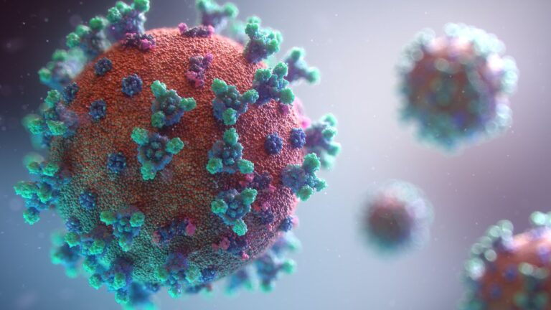
Real-life effect of the BNT162b2 vaccine for Coronavirus Disease 2019 (COVID-19)
Presented by:
Ashley Newman
& Michal
Weinbaum
June 6th , 2022

Slide 2
Agenda:
COVID-19 & the Pfizer-BioNTech vaccine
Survival Analysis
BNT162b2 mRNA COVID-19 Vaccine in a Nationwide Mass Vaccination setting (paper I)
COVID-19 dynamics after a national immunization program in Israel (paper II)

Slide 3
Agenda:
COVID-19 & the Pfizer-BioNTech vaccine
Survival Analysis
BNT162b2 mRNA COVID-19 Vaccine in a Nationwide Mass Vaccination setting (paper I)
COVID-19 dynamics after a national immunization program in Israel (paper II)

Slide 4
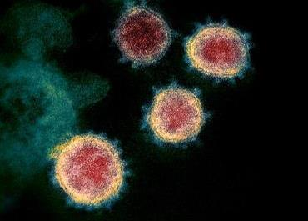
What is COVID-19?
Coronaviruses are a large family of viruses that are known to cause a range of illnesses from the common cold to more severe diseases such as Severe Acute Respiratory Syndrome (SARS).
SARS-Cov-2 infections cause the disease COVID-19.
The WHO declared COVID–19 a pandemic in March, 2020.
Source: NIAD: https://www.flickr.com/photos/niaid/49534865371/
Notes:
NIH describes coronaviruses as a large family of viruses that usually cause mild to moderate upper-respiratory tract illnesses in humans. However, 3 coronaviruses have causes more serious and fatal in people: SARS coronavirus which emerged in November 2002 and causes severe acute respiratory syndrome; MERS coronavirus, which emerged in 2012 and causes Middle East respiratory syndrome; and SARS-CoV-2, which emerged in 2019 and causes coronavirus disease 2019 (COVID-19).

Slide 5
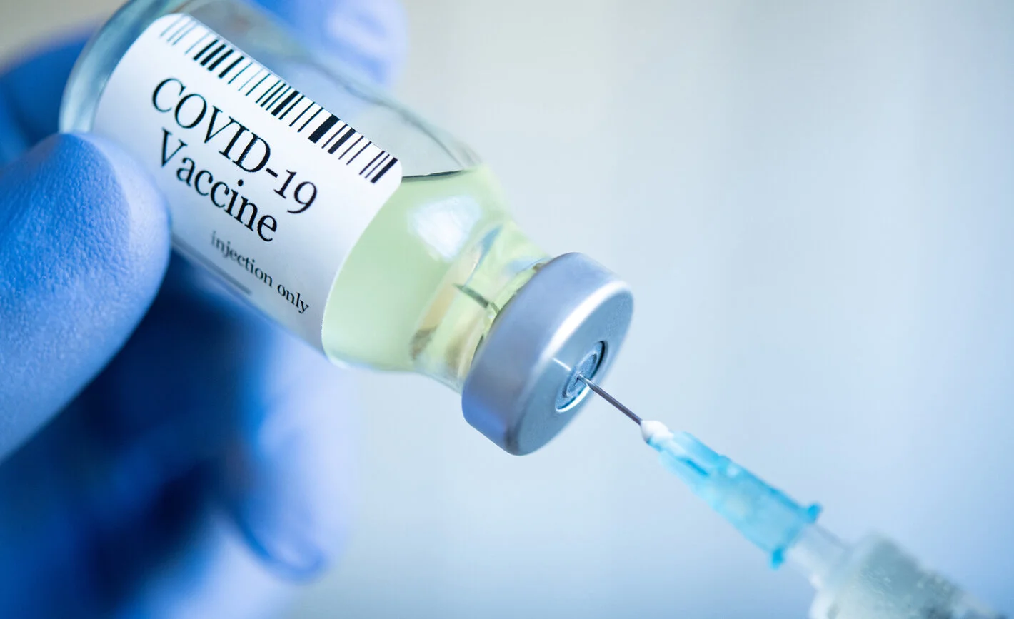
The BNT162b2 vaccine was developed by BioNTech in Cooperation w/ Pfizer.
Two doses of the Pfizer vaccine, administered 21 days apart, conferred 95% protection against COVID-19 in adults ages 16+.
Notes:
The vaccine referred to in our papers and used in Israel was developed by BioNTech in cooperation with Pfizer.
2 doses of the Pfizer vaccine, administered 21 days apart, conferred 95% protection against covid-19 in adults ages 16+ (According to the study in The new England journal of medicine, Fernando P. Polack, 2020)

Slide 6
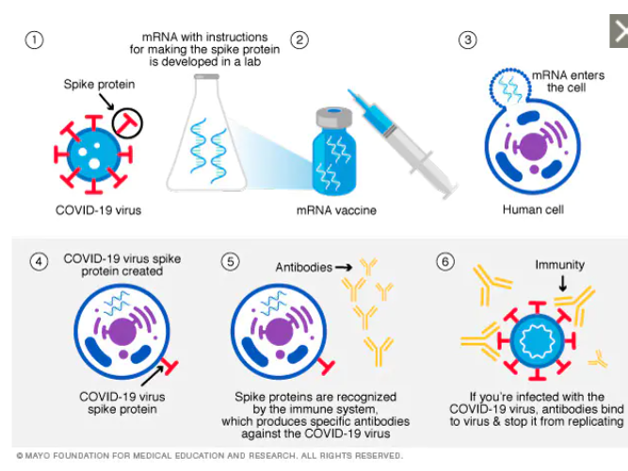
How the mRNA Vaccine Works
Notes:
A mRNA vaccine is made using mRNA that gives your cells instructions for how to make the spike protein found on the surface of the COVID-19 virus. After vaccination, your immune cells begin making the spike protein and displaying them on cell surfaces. This causes your body to create antibodies that can fight the COVID-19 virus.

Slide 7
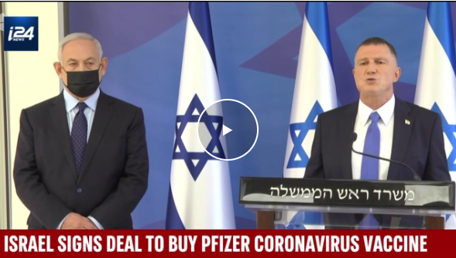
Israel locked in an early supply of Pfizer-BioNTech vaccines with its unique deal: paid a premium and supplied data for the early access. (Source: NPR)
Israel's small size and technologically advanced public health system offered an attractive model for Pfizer to demonstrate the impact of the vaccine on an entire population. (Source NPR)
Nearly every Israeli citizen and resident belongs to one of four public HMOs, a health care system rooted in the national trade union of Israel's early years. Every Israeli's full medical history – from physician visits to hospitalizations – is accessible to any health provider at the click of a mouse, a repository of digital records going back 30 years. (Source:NPR)
Notes:
Both of the papers investigated vaccination efforts within Israel. Before we delve into details of the studies, I want to give a refresher of the events that happened within the country during the study period of the papers.
israel was able to get early access to the vaccine by paying a premium for it and by agreeing to provide data in exchange to Pfizer.
israel was able to get early-access as it had the advantage of being a small country and having a well-established technologically-advanced public health system that could demonstrate the effects of the vaccine on an entire population.
As you all know, Israel is unique in the world by having a healthcare system where almost all Israelis belong to just 1 of 4 public HMO’s (health maintenance organization) and all of a given patient’s health history from the past 30 years has been digitally recorded

Slide 8
Agenda:
COVID-19 & the Pfizer-BioNTech vaccine
Survival Analysis
BNT162b2 mRNA COVID-19 Vaccine in a Nationwide Mass Vaccination setting (paper I)
COVID-19 dynamics after a national immunization program in Israel (paper II)

Slide 9
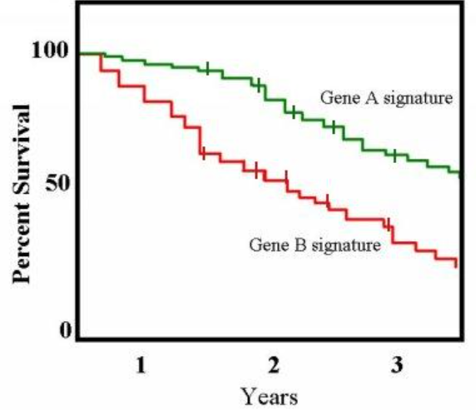
Survival Analysis (Time to Event Analysis)
Survival Analysis is used to estimate the lifespan of a particular population under study, as compared to a reference population

Slide 10
Kaplan-Meier (K-M) Curve (1958)
• Dealing with different survival time
with incomplete observations
• It shows the probability of an event at a certain time interval
• The lines represent survival curves of the two groups.
• A vertical drop in the curves indicates an event.
• The vertical tick mark on the curves means that a patient was censored at this time.
• At time zero, the survival probability is 1.0 (100%)
35%

Slide 11
Collecting data in a trial:
0
1
2
3
4
5
6
Time (years)

Slide 12
Align samples:
event
censored
censored
event
0
1
2
3
4
5
6
Time (years)

Slide 13
ID | Time | Event | Group
A | 5 | 1 | 1 – (green)
B | 4 | 0 | 2 – (orange)
C | 5 | 0 | 2 – (orange)
D | 3 | 1 | 2 – (orange)
A
event
B
censored
C
censored
D
event
0
1
2
3
4
5
6
Time (years)

Slide 14
1
Kaplan-Meier (K-M) Curve
Only 1 group
Sort events by time order
0.5
1
2
3
4
5
6
time | event | # at risk | survive | cumulative survival rate (probability)
0 | 0 | 6 | 6/6 | 6/6=1
1 | 1 | 6 | 5/6 | 6/6*5/6=0.833
3 | 1 | 5 | 4/5 | 6/6*5/6*4/5=0.667
4 | 1 | 4 | 3/4 | 6/6*5/6*4/5*3/4=0.5
4.5 | 0 | 3 | 3/3 | 6/6*5/6*4/5*3/4*3/3=0.5
5 | 1 | 2 | 1/2 | 6/6*5/6*4/5*3/4*3/3*1/2=0.25

Slide 15
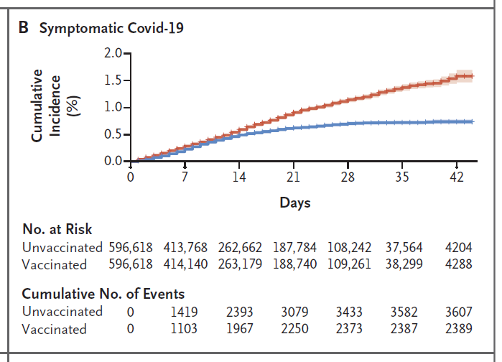
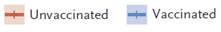
Cumulative incidence Curve (K-M)
• Survival Cumulative incidence graphs show the opposite relationship
• This is the sum of events incidences occurring up to that time
• This can be mathematically described as being 1 - survival probability.
• Thus, these graphs start at 0 and increase to a maximum of 1
• The cumulative incidence of event up to a given time is the probability that an individual dies by that time.
• Cumulative incidence is calculated as the number of new events divided by the total number of individuals in the population at risk for a specific time interval
35%

Slide 16
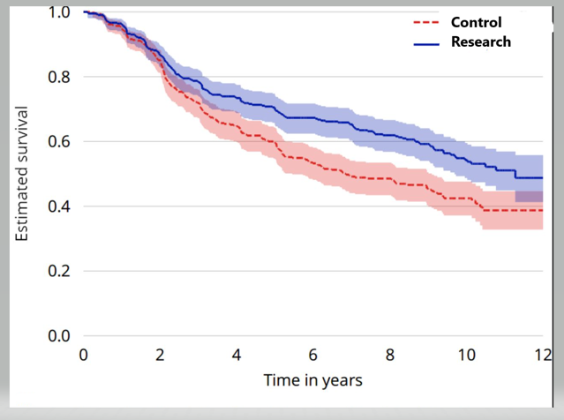
Comparison of K-M estimates
• Simple to visualize the difference
• Must be quantified in order to assess statistical significance.
• Plotting confidence intervals can be useful in visualizing the differences.
• The log rank test is the most common method.
It calculates the chi-square (X2) for each event time for each group.
The summed results for each group are added to derive the ultimate chi-square to compare the full curves.
• Hazard ratio, which gives a relative event rate in the groups. Cumulative process provide the hazard ratio of the full curves.
Notes:
Simple to visualize the difference between two survival curves, but the difference must be quantified in order to assess statistical significance.
Plotting confidence intervals can be useful in visualizing the differences.
The log rank test is the most common method. The log rank test calculates the chi-square (X2) for each event time for each group and sums the results. The summed results for each group are added to derive the ultimate chi-square to compare the full curves of each group.
Another method is using the hazard ratio, which gives a relative event rate in the groups. Again the same cumulative process as performed in the log rank test; thus, the hazard ratio refers to the results of the full curves.
X2 from the log-rank test will suggest whether two curves are statistically different. The Cox proportional hazards will show the increased rate of having an event in one curve versus the other.

Slide 17
Agenda:
COVID-19 & the Pfizer-BioNTech vaccine
Survival Analysis
BNT162b2 mRNA COVID-19 Vaccine in a Nationwide Mass Vaccination setting (paper I)
COVID-19 dynamics after a national immunization program in Israel (paper II)

Slide 18
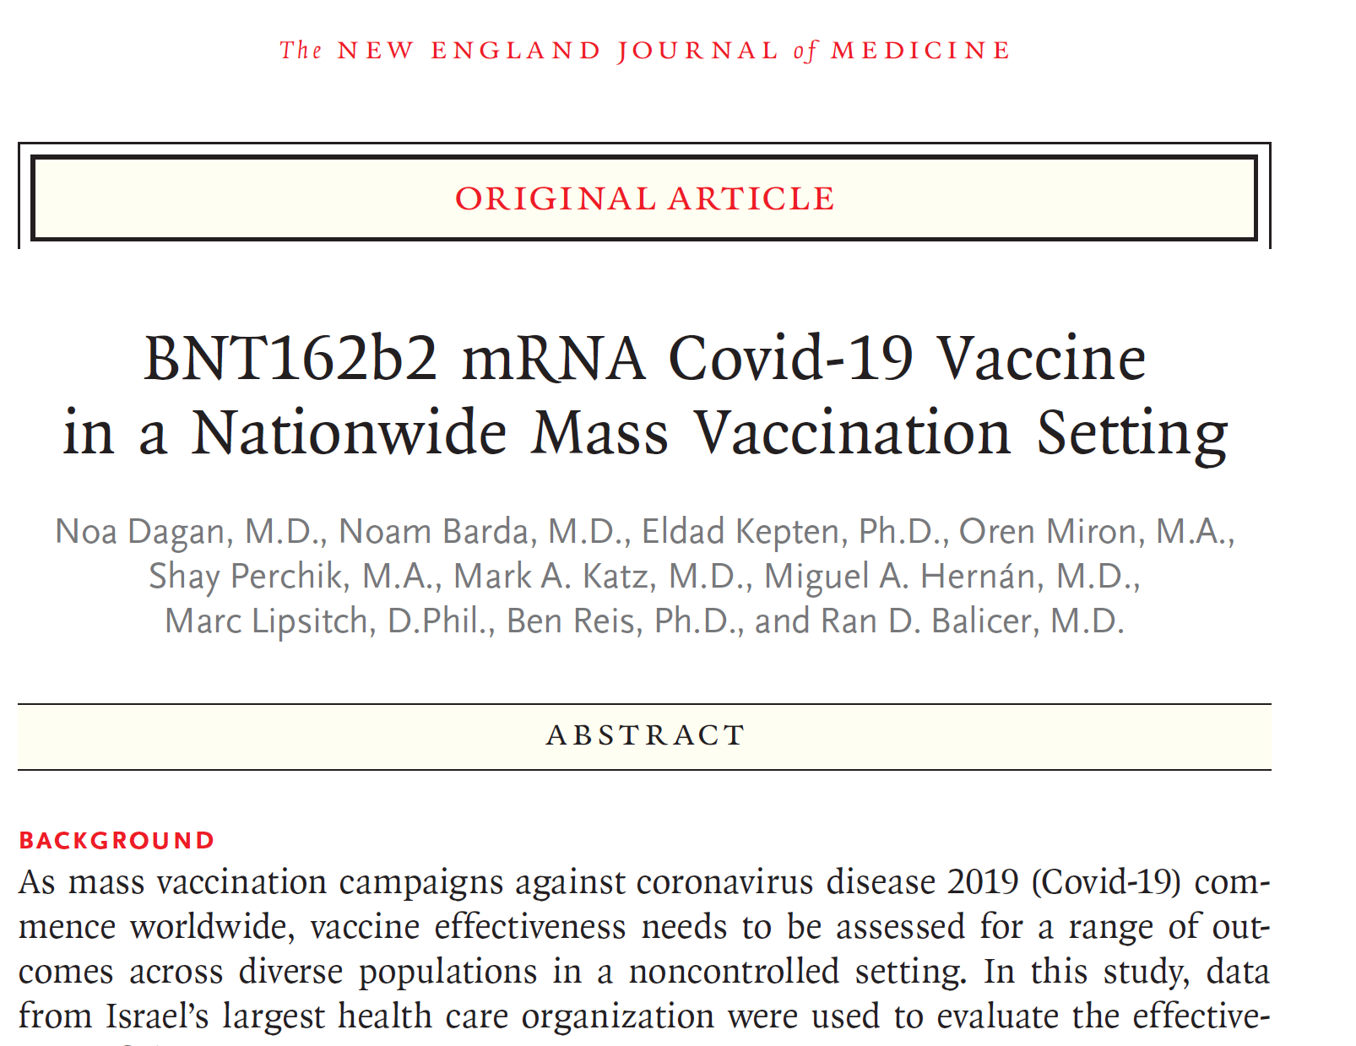
BNT162b2 mRNA COVID-19 Vaccine in a Nationwide Mass Vaccination setting
Authors: Noa Dagan, Noam Barda, et al.
Published: 24 February, 2021 in NEJM.org

Slide 19
Research time period:
Dec 20th,2020-Feb 1st,2021
Vaccination Periods:
Days 14-20 after 1st dose
Days 21-27 after 1st dose
Days 7-until the end of the follow-up after 2nd dose
In Secondary analysis:
Days 0-20 after 1st dose
Days 0-27 after 1st dose
Days 0-until the end of the follow-up after 1st dose
Days 0-6 after 2nd dose

Slide 20
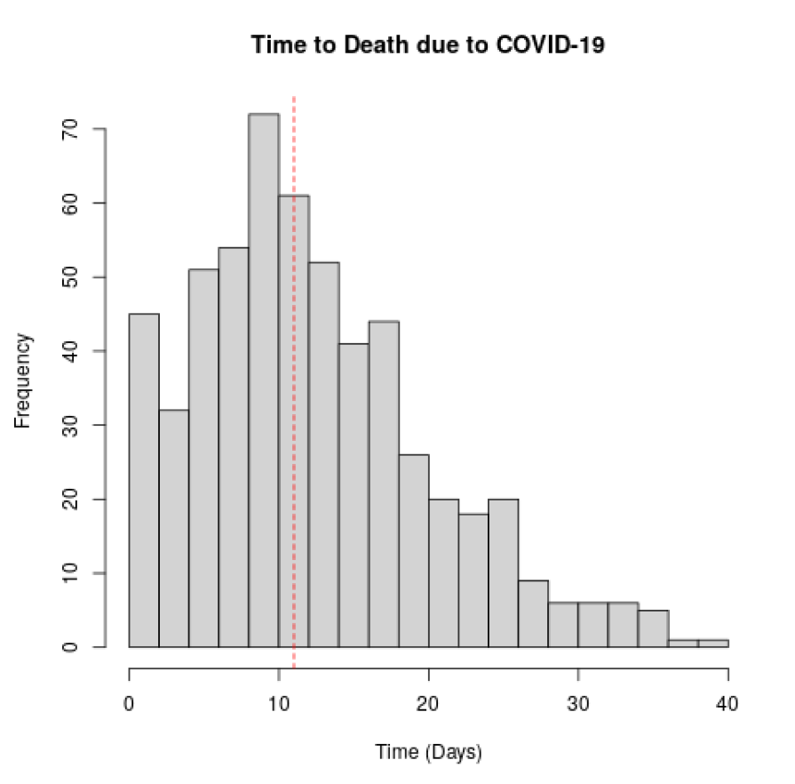
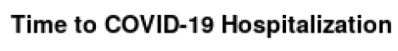
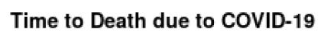
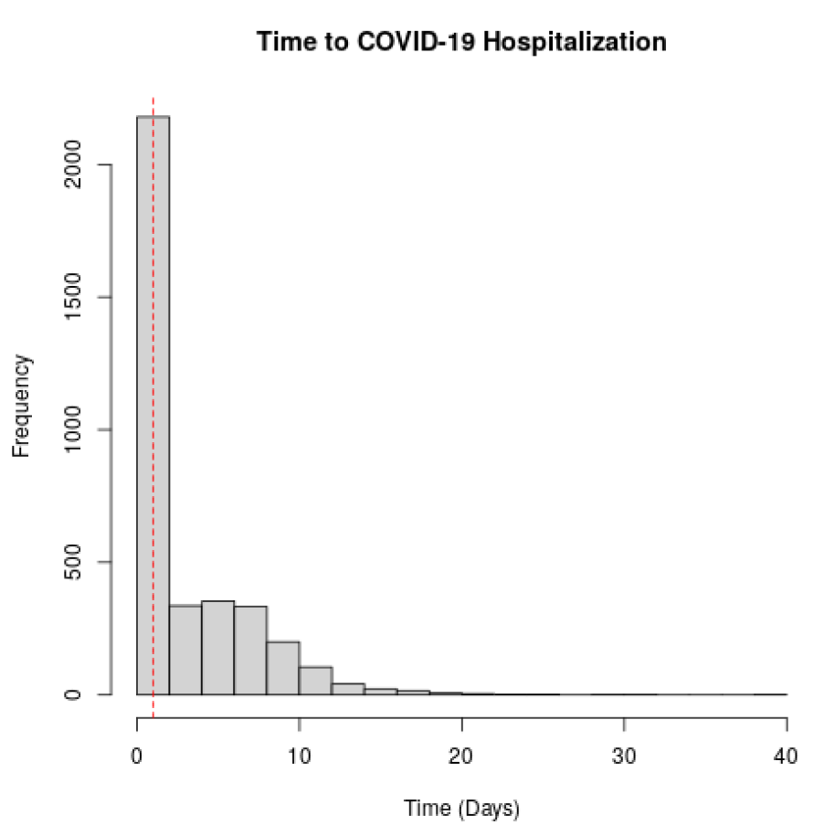
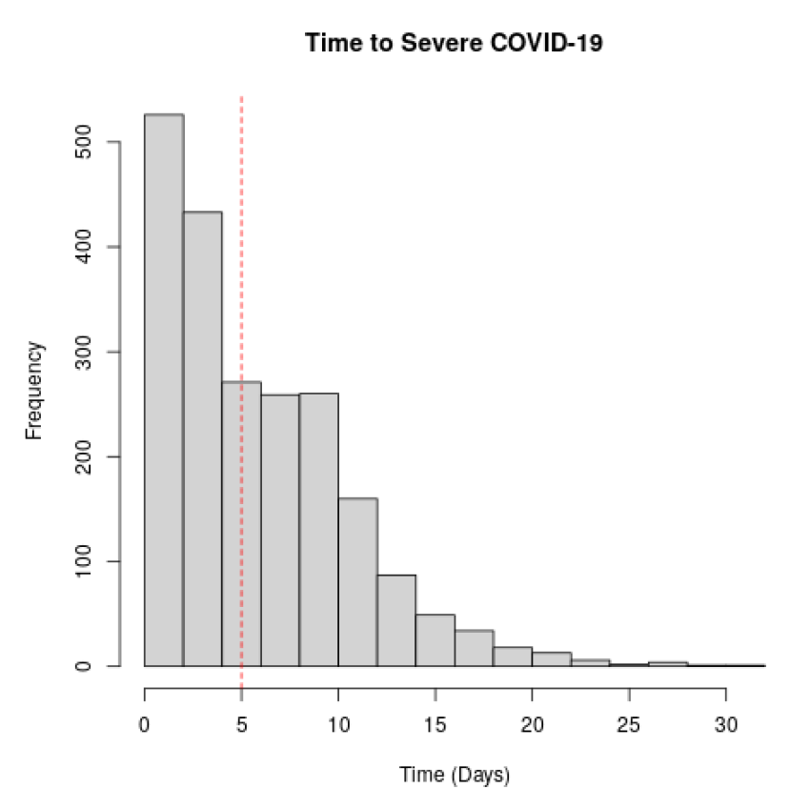
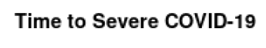
Estimated effectiveness for 5 outcomes were analyzed:
Documented SARS-CoV-2 Infection
Symptomatic Covid-19
Coved-19 Hospitalization
Severe Covid-19
Death due to Covid-19
Time from Initial PCR Swabbing to outcomes
Median=1
Median=5
Median=11

Slide 21
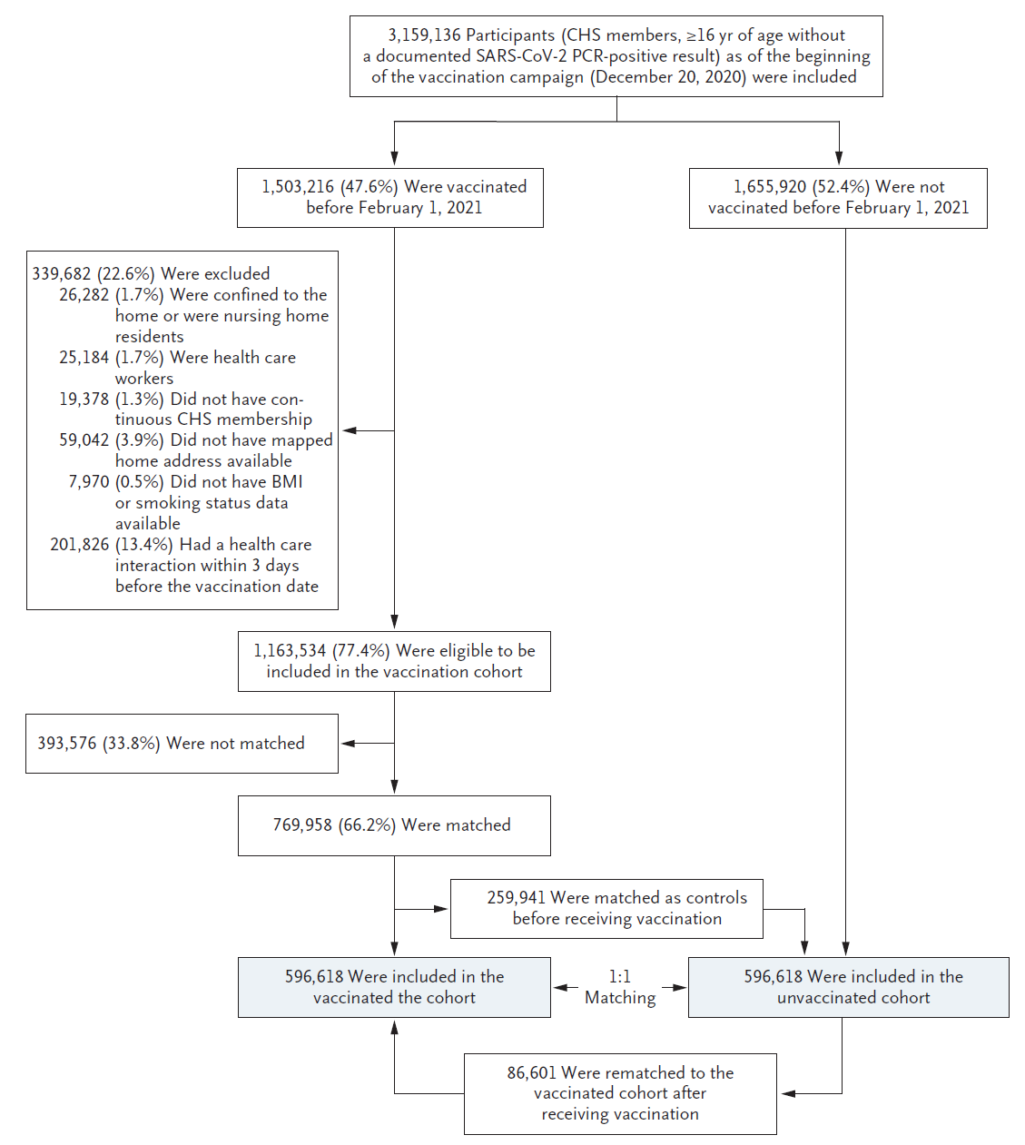
Included:
Clalit members , > 16 years,
no covid documented till 20.12.2020
Excluded:
Home or nursing home residense
Health workers
Leave Clalit, no home address
No BMI or smoking status
Healtcare interaction 3 days before vaccination
**
Some were matched in control before receiving vaccination
Some were rematched in vaccinated cohort after receiving vaccination

Slide 22
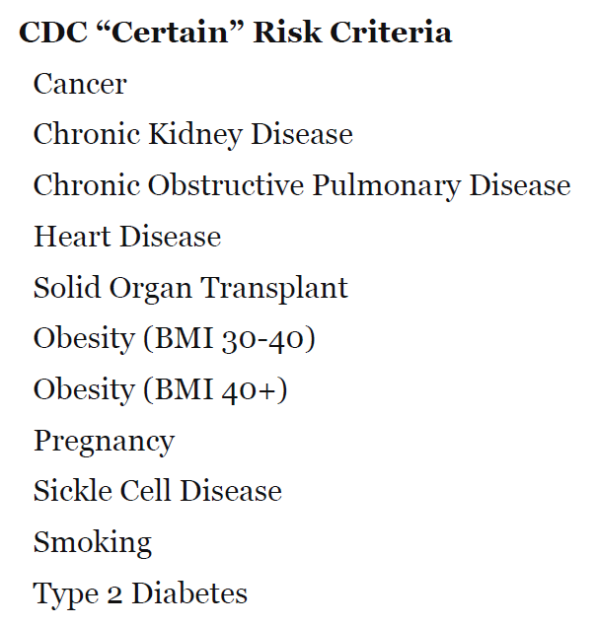
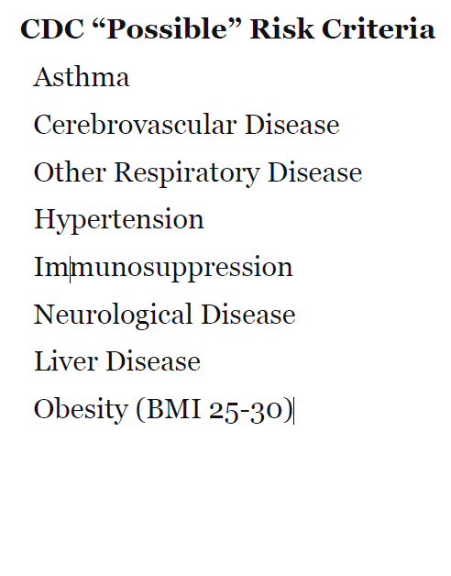
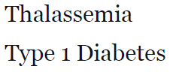
Matching Groups:
• Age (16-39,40-49,50-59,60-69,70-79,80+), in bins of two consecutive years
• Sex (male, female)
• Place of residence, at the level of neighborhood or small town
• Population Sector (general Jewish, Arab, ultra-orthodox Jewish)
• Influenza vaccines in the past 5 years (0, 1-2, 3-4, 5)
• Pregnancy (yes, no)
• Count of pre-existing conditions considered by the CDC as risk criteria (0,1,2,3,4+)

Slide 23
Statistical tests method:
• Using the Kaplan–Meier estimator with daily outcome and censoring events to compute the probability (“risk”) of the outcome during the Period. Then risk ratios for vaccination as compared with no vaccination was calculated.
vaccine effectiveness is one minus the risk ratio (1-RR).
• Risk difference per 1,000 patients for different populations (RD)
• A 95% confidence interval using the percentile bootstrap method with 500 repetitions was calculated
Notes:
If for example 1-RR=90%, it means that the ratio is 1:10 events between vaccinated and not.
The risk difference is calculated by subtracting the cumulative incidence in the unvaccinated group from the cumulative incidence in the vaccinate group.

Slide 24
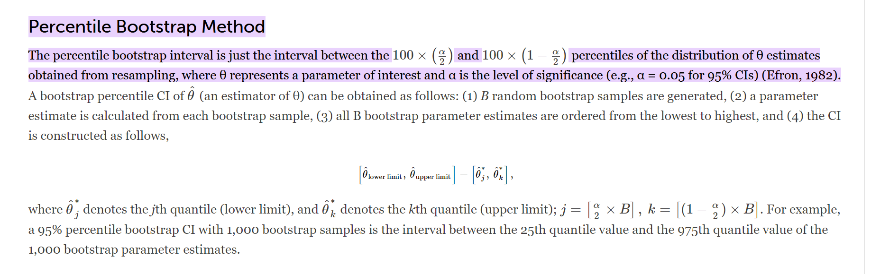

Slide 25
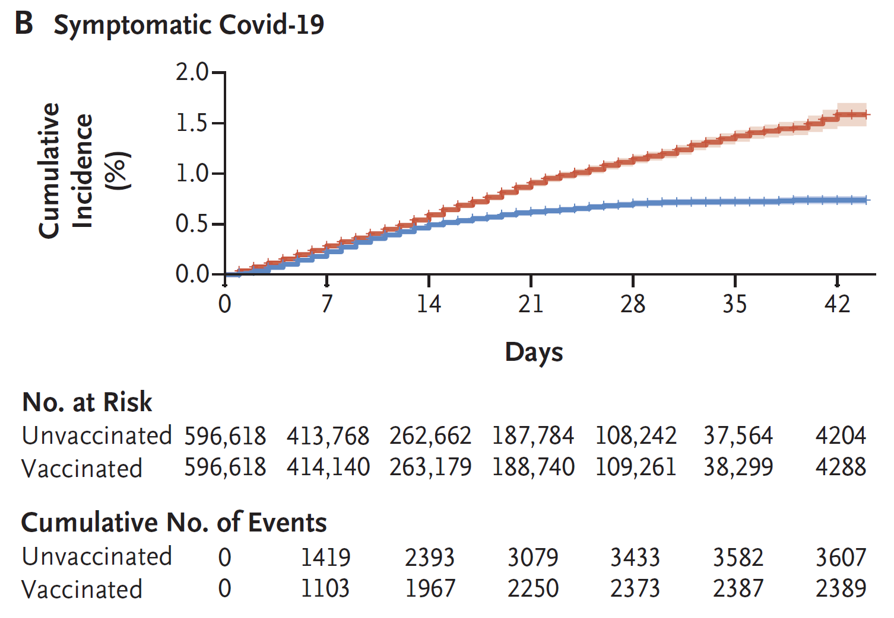
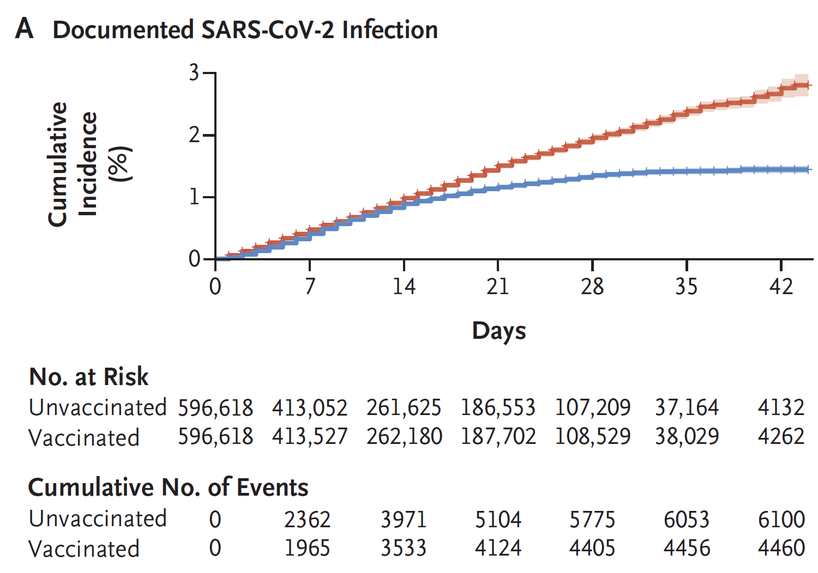
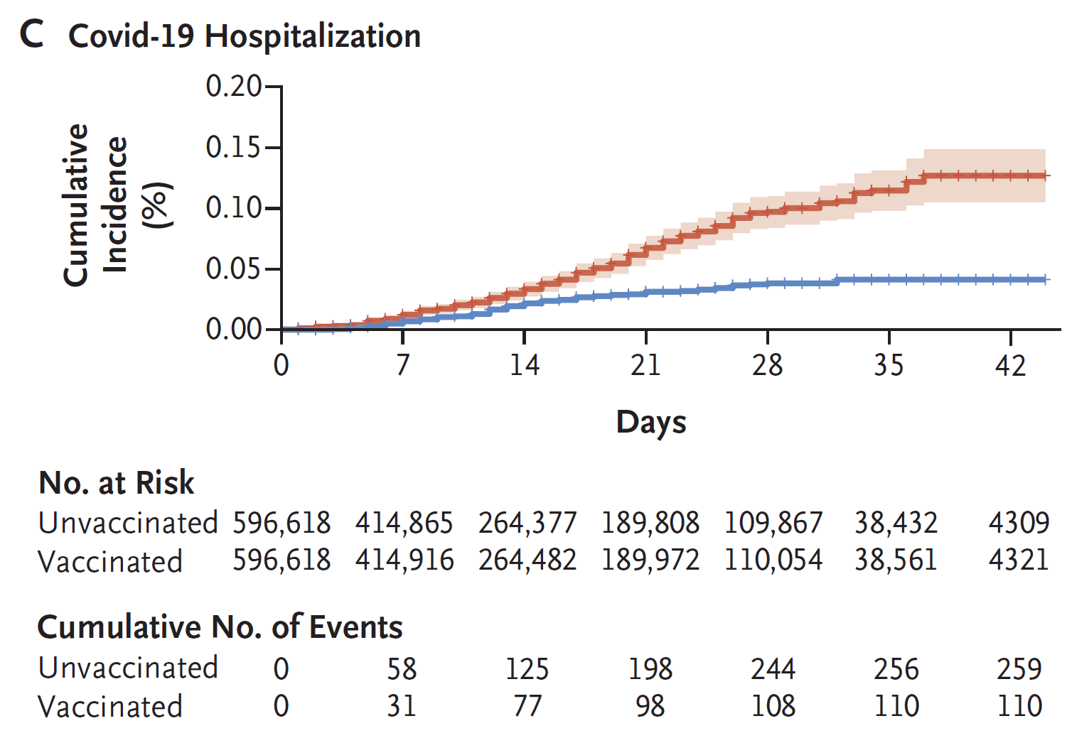
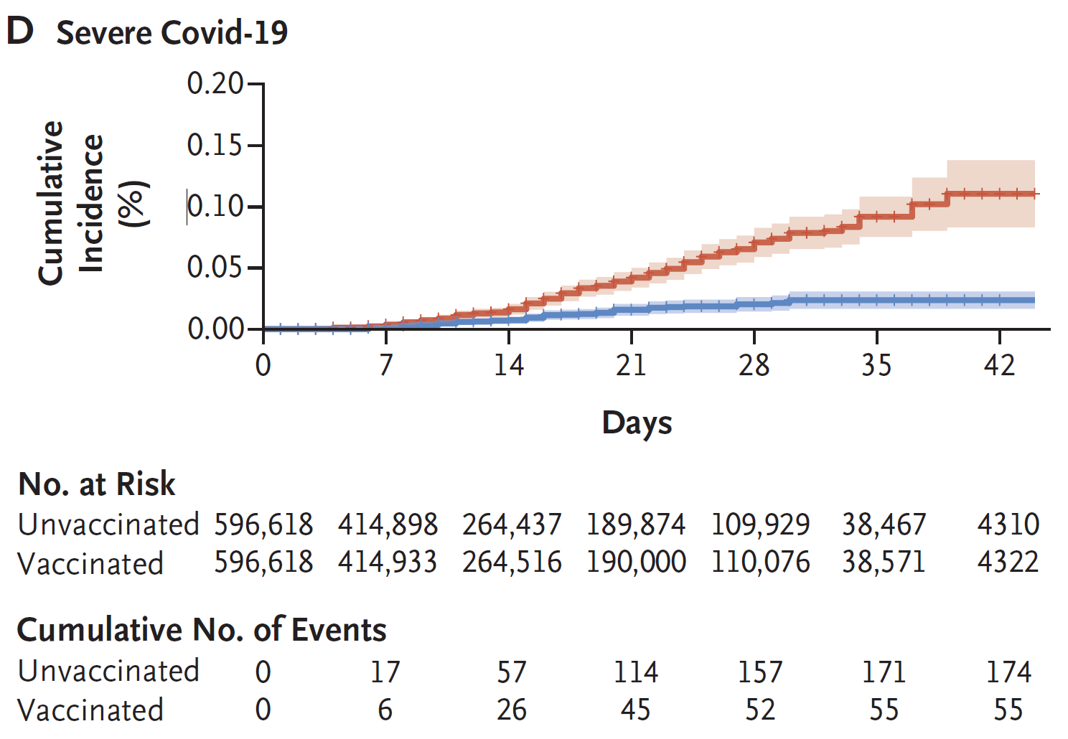
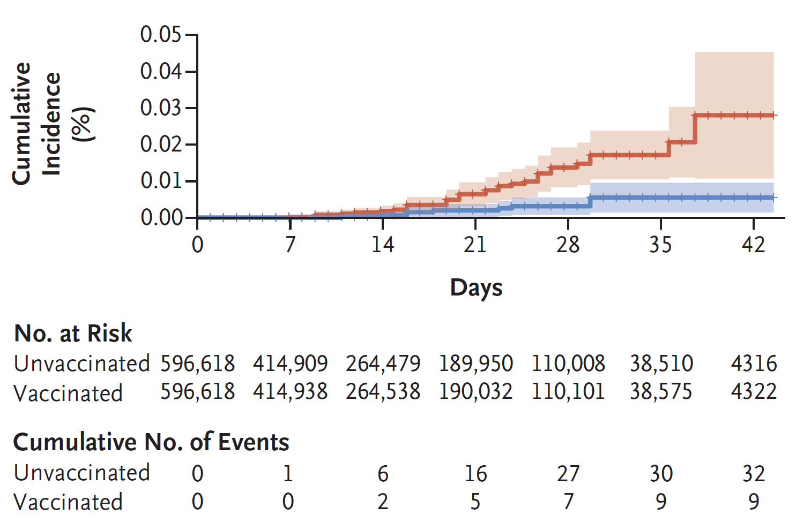
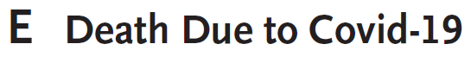
Results:
• Cumulative incidence of symptomatic Covid between vaccinated vs. non start to diverse around day 12
• a temporary increase in events among unvaccinated during the few first days after the 1st vaccine dose, most likely stemming from the fact that persons who choose to be vaccinated on a specific day are feeling well at the time of vaccination

Slide 26
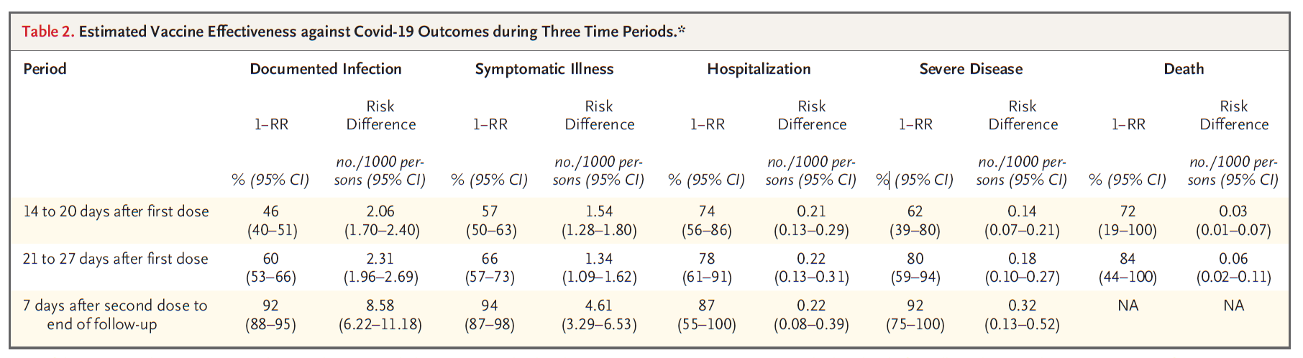
Results:
• 94% efficacy of vaccination 7+days after 2nd dose vs. 95% in randomized trial
• efficacy between 1st dose and 2nd dose 29% vs 52% in the trial
• in the trial severe Covid only 10 case vs. 229 in this study.
• To assess a possible selection bias that could stem from informative censoring, whereby controls who are vaccinated feel well around the time of vaccination, we performed a sensitivity analysis in which they were kept in the unvaccinated group for a period of time that was set differently for each outcome. Results were similar to the main analysis → any such bias was small in our analysis

Slide 27
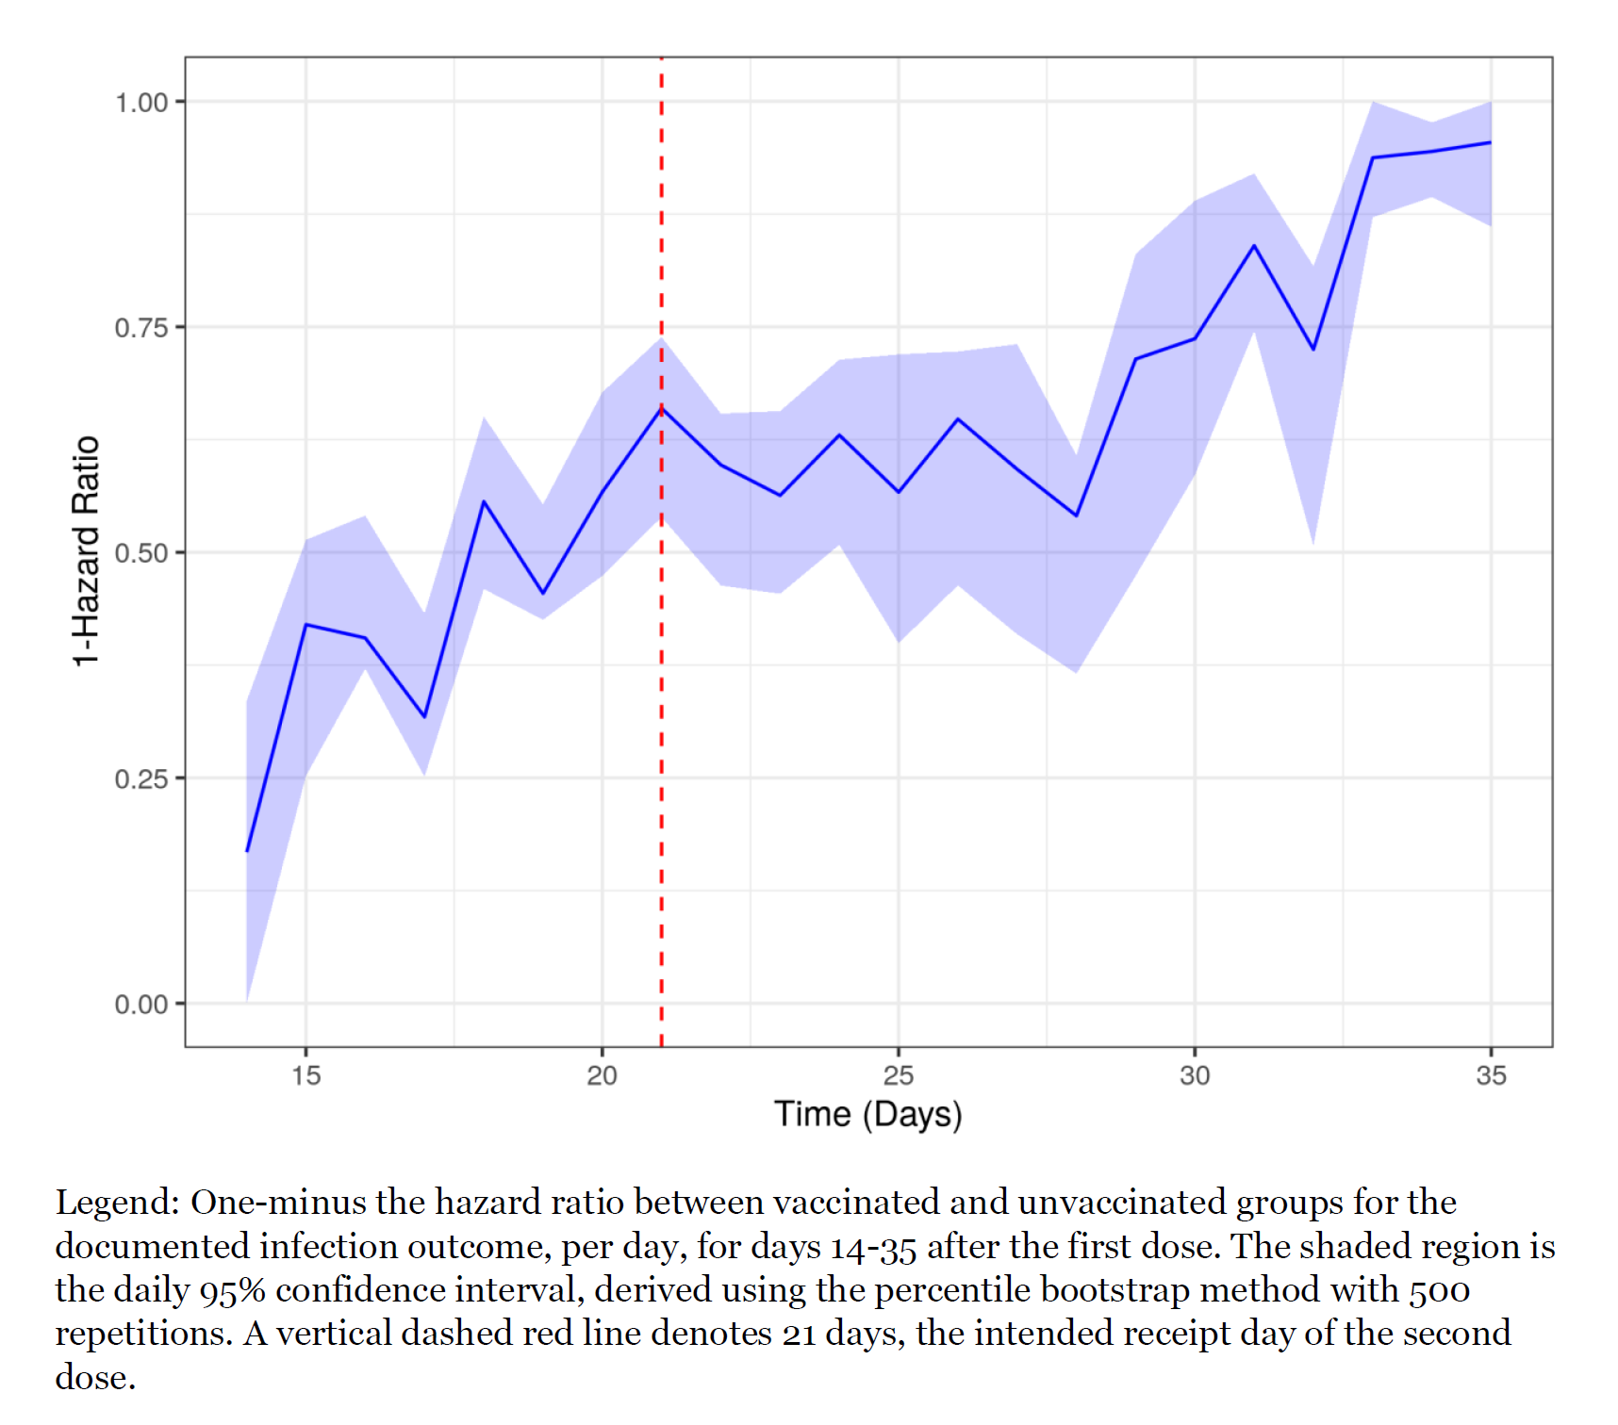
Results
• During a mean follow-up of 15 days (interquartile range, 5 to 25), 10,561 infections were documented (0.6 infections per 1000 person-days), of which 5996 (57%) were symptomatic Covid-19 illness, 369 required hospitalization, 229 were severe cases of Covid-19, and 41 resulted in death.
• During follow-up, 96% received a 2nd dose of vaccine (95% before day 24)
• Effectiveness estimates conditional on receipt of the 2nd dose of vaccine were higher than unconditional estimates for days 21-27 after the 1st dose.

Slide 28
Males
 | PCR+ | Symptoms | Hospital | Severe | Death
14-20 | 41% | 52% | 71% | 66% | 73%
21-27 | 57% | 62% | 50% | 82% | 85%
7+ (2nd) | 91% | 88% | 84% | 90% | NA
Females
 | PCR+ | Symptoms | Hospital | Severe | Death
14-20 | 50% | 60% | 75% | 58% | 68%
21-27 | 63% | 69% | 96% | 79% | NA
7+ | 93% | 96% | NA | NA | NA
16-39
 | PCR+ | Symptoms | Hospital | Severe | Death
14-20 | 49% | 57% | 74% | NA | NA
21-27 | 64% | 67% | NA | NA | NA
7+ (2nd) | 94% | 99% | NA | NA | NA
70+
 | PCR+ | Symptoms | Hospital | Severe | Death
14-20 | 22% | 44% | 38% | 50% | 68%
21-27 | 50% | 64% | 49% | 62% | 79%
7+ | 95% | 98% | NA | NA | NA
No Risk Criteria
 | PCR+ | Symptoms | Hospital | Severe | Death
14-20 | 49% | 55% | 92% | 65% | NA
21-27 | 66% | 73% | 76% | 100% | NA
7+ (2nd) | 91% | 93% | NA | NA | NA
3+ Risk Criteria
 | PCR+ | Symptoms | Hospital | Severe | Death
14-20 | 37% | 62% | 70% | 62% | 64%
21-27 | 37% | 47% | 62% | 81% | 78%
7+ | 86% | 89% | NA | 88% | NA

Slide 29
Agenda:
COVID-19 & the Pfizer-BioNTech vaccine
Survival Analysis
BNT162b2 mRNA COVID-19 Vaccine in a Nationwide Mass Vaccination setting (paper I)
COVID-19 dynamics after a national immunization program in Israel (paper II)

Slide 30
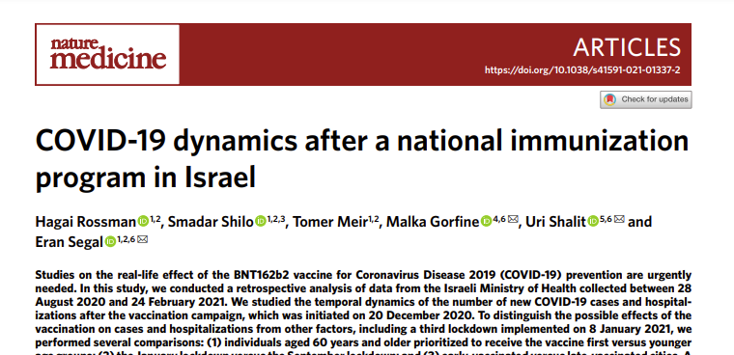
COVID-19 dynamics after a national immunization program in Israel
Authors: Hagai Rossman, et al.
Published: 19 April, 2021 in Nature Medicine
Notes:
The paper was a retrospective analysis of data from the Israeli Ministry of Health collected between August 28, 2020 and February 24, 2021 (roughly a 6-month period). The author’s motivation behind the study was that there were already many studies/reports that can attest to the vaccine’s effectiveness. However, there are very few studies that investigate the effect of a vaccination campaign on the patterns of pandemic dynamics at the population level.

Slide 31

*THE STUDY*
A retrospective analysis of data from the Israeli Ministry of Health collected between
28 August 2020 and 24 February 2021
Data was comprised of:
Age
Gender
Date of Positive PCR test
Date of Hospitalization
Clinical State During Hospitalization
Date of Death OR Recovery
Daily Vaccine Doses in Israel
-First or Second dose
-City administered in
-Age group (within a decade)
Groups:
3,210,200 Vaccinated Individuals w/ both doses
711,949 recovered individuals (not eligible for the vaccine)
Notes:
Data was comprised of Age, Gender, positive PCR date, hospitalization date, clinical state during hospitalization, date of death or recovery, daily vaccine doses in Israel, whether it was the 1st or 2nd dose, city dose was given in, age group (grouped by decade).
The groups analyzed were 3,210,200 vaccinated individuals w/ both doses and 711,949 recovered individuals (not eligible for the vaccine at the time)

Slide 32
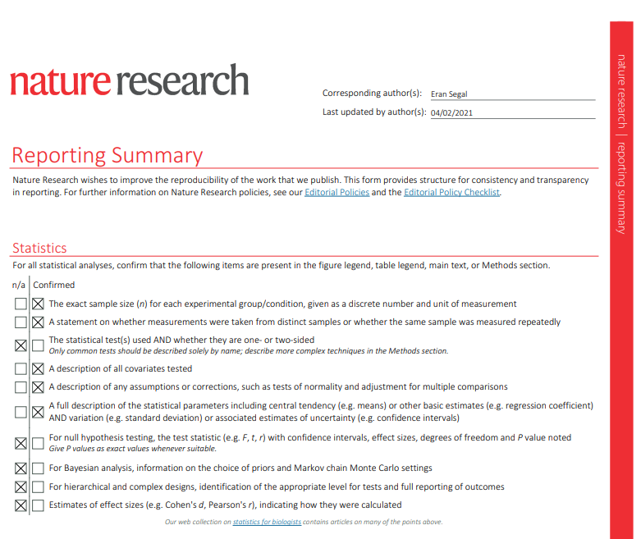
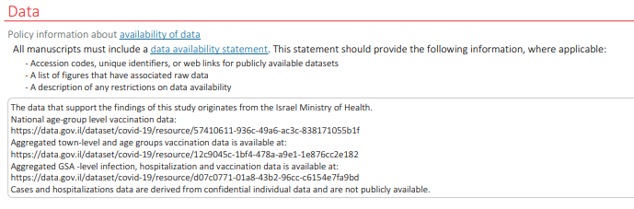
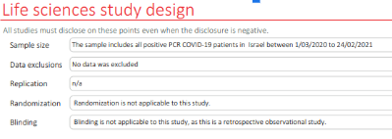
Notes:
This is a reporting summary that was available as an addendum in the Nature article with the purpose to improve transparency of reporting.
As you can see, statistical test(s) were not used since it was just an observational study. Some of the data is publically available and was taken from the data.gov.il website. The cases and hospitalizations data was confidential and is not publically provided.The authors analysis used data visualizations to show the impact of the vaccination campaign

Slide 33

How to evaluate the vaccine’s effect?
Direct effects of the vaccine on vaccinated individuals (vaccine effectiveness)
Impact of the vaccination program on entire population (vaccine impact)
Notes:
We can evaluate a vaccine’s effectiveness based on the vaccine’s efficacy on vaccinated individuals (which was not studied in this paper but already proven and also discussed in Michel’s paper). We can also evaluate a vaccine’s effectiveness by the impact of a government’s vaccination program on the entire population, which was studied in this paper. Specifically, the authors looked at the effect of the unique Israeli vaccination rollout program on different measures of the pandemic such as infection rate, death rate, and hospitalization.

Slide 34
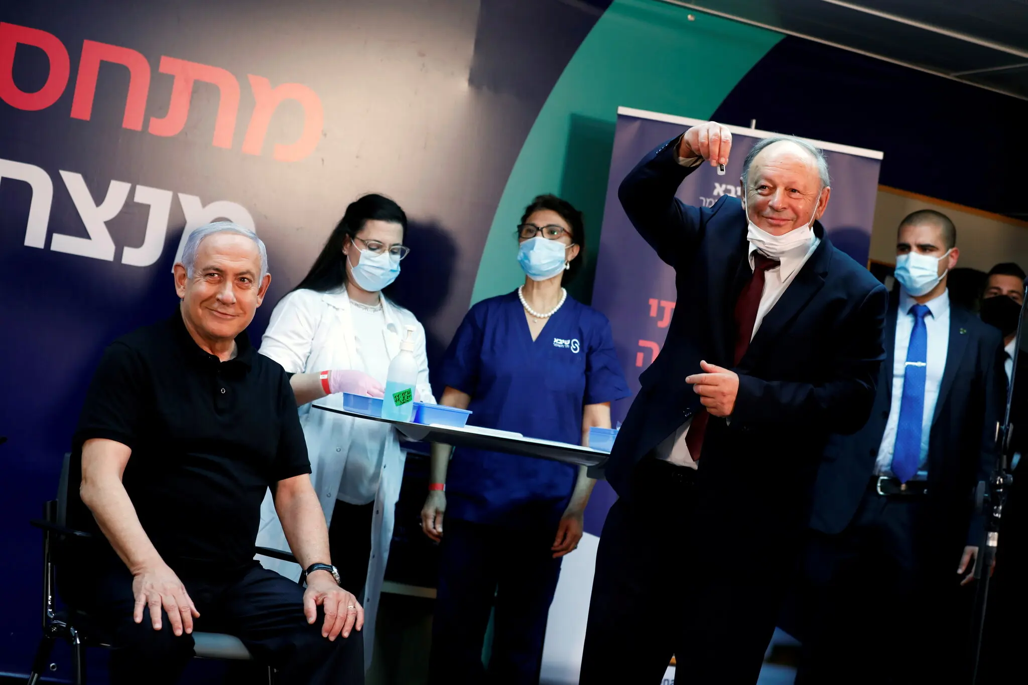
The Vaccination Campaign was initiated on 20 December 2020.
Former PM Benjamin Netanyahu was the first Israeli to receive the vaccine.
Source: Amir Cohen/ Reuters
Notes:
Israel’s vaccination campaign was initiated on December 20th 2020. And by vaccination campaign, the author refers to the administration of covid vaccines to the public.

Slide 35
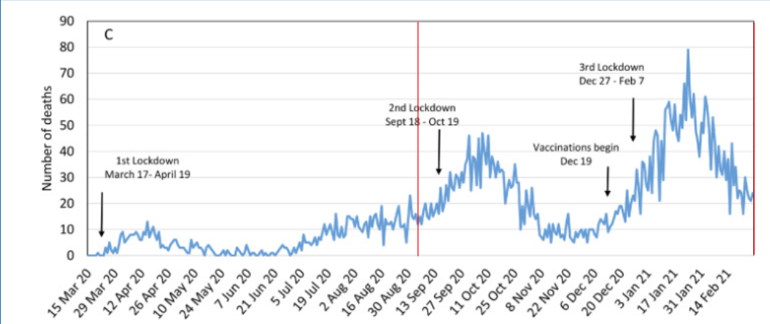
A retrospective analysis of data from the Israeli Ministry of Health collected between
28 August 2020 and 24 February 2021
Source: The Lancet
Notes:
The vertical red lines in this graph delineate the study period, which began on August 28, 2020. Israel’s second lockdown began roughly one month later on September 18, which lasted until October 19. The vaccination campaign started on Dec 20th. The third lockdown began December 27 and ended February 7, 2021. The study period ended on February 24.

Slide 36
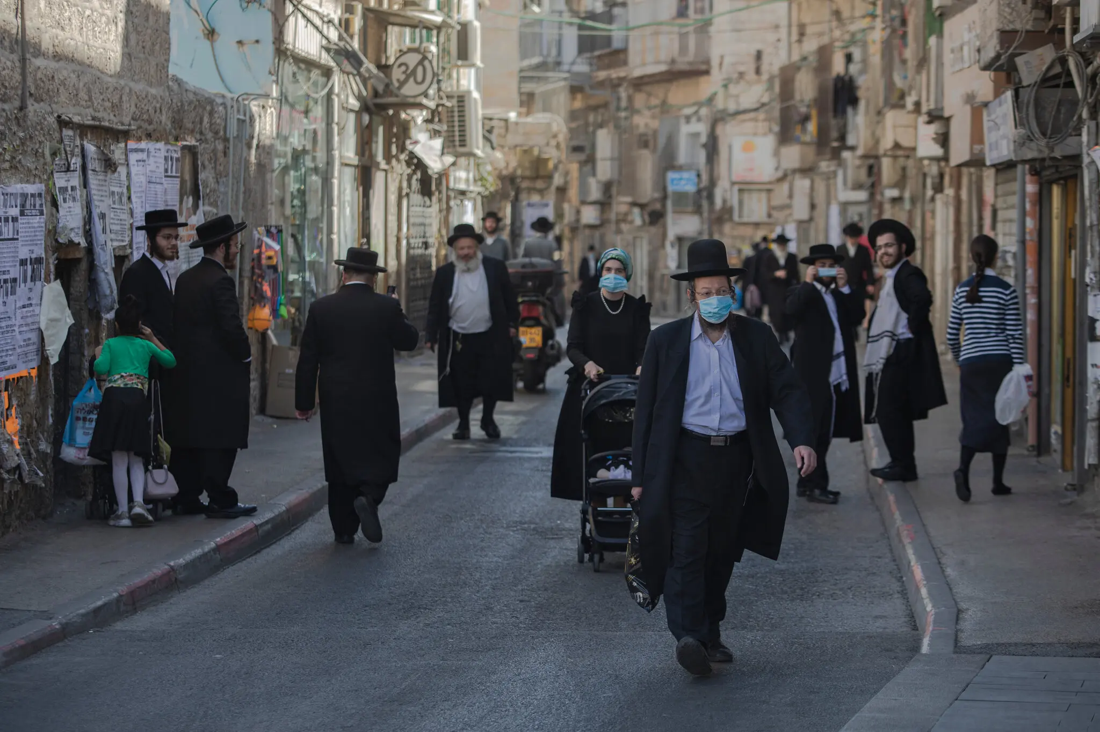
Several Notable Comparisons in the Study to Mitigate the Influence of External Factors
60+ prioritized to first receive vaccinations
Impact of 2nd versus 3rd national lockdown
Early vaccinated versus late vaccinated cities
Israel’s ultra-Orthodox community has been hit hard by the pandemic. Outreach efforts have helped address resistance to vaccine.
Source: Dan Balilty/ The New York Times
Notes:
The authors made 3 notable comparisons in the study. They compared 60+ and older age group (who were prioritized to receive the vaccine earlier) versus younger individuals. They compared the impact of the second lockdown before the vaccines were available versus the third lockdown after vaccines were available. And they also compared early vaccinated versus late vaccinated cities.

Slide 37
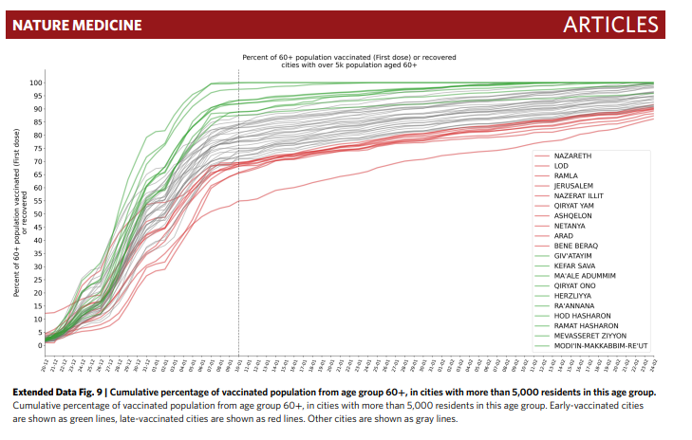
Notes:
Early-vaccinated cities are shown in green & were defined as the 10 top cities in Israel w/ the highest percentage of the 60+ population vaccinated by Jan 10th 2021. To be included in the ranking, the city must have at least 5,000 60+ residents. The late-vaccinated cities were the 10 lowest ranking and are shown in red.

Slide 38
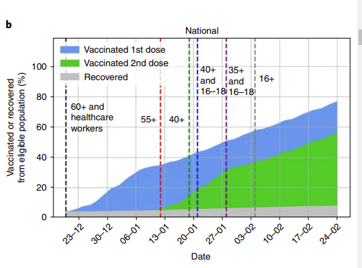
Israel has one of the highest rates of vaccinated individuals per capita:
48.8% received first vaccine as of 24 Feb 2021
Notes:
The graph shows when different age groups were allowed to get their vaccines in the vaccination campaign.

Slide 39
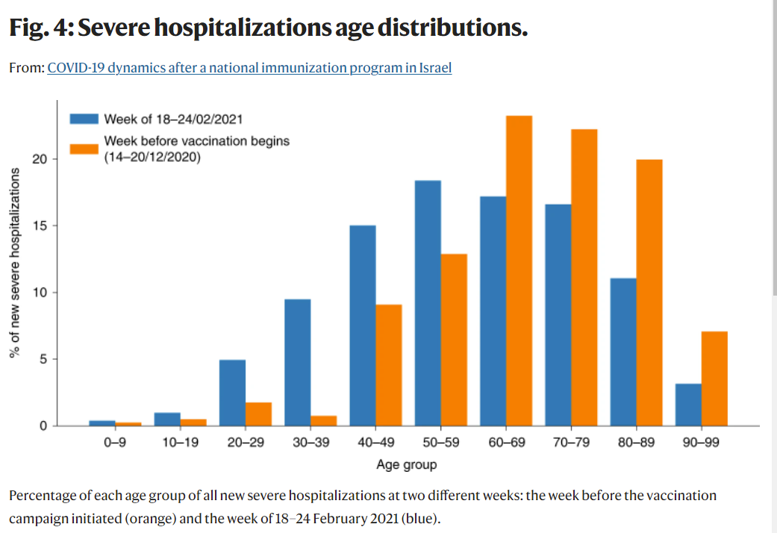
Results
Notes:
The bar graph shows the percentage of all severe new hospitalizations in each age group at 2 different weeks. The week before the vaccine rollout is in orange and the week of February 18-24 (roughly 2 months into the vaccine rollout) is in blue. You can see a larger decrease in the 60+ age group. And you can see a considerable shift toward younger ages of patients w/ severe hospitalizations, which corresponded w/ the vaccination campaign and it’s prioritizing 60+ individuals to be first vaccinated.

Slide 40
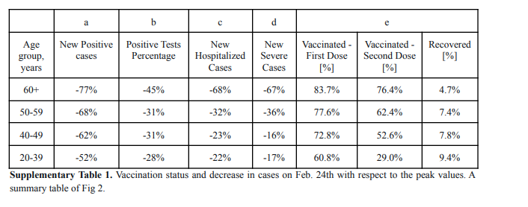
Notes:
This table shows the % change in the number of new cases and hospitalizations on the last day of the study from peak values. You can see across the board that the 60+ age group had the largest decrease in new cases as they were the first to be vaccinated in the campaign and therefore had the highest vaccination percentage.

Slide 41
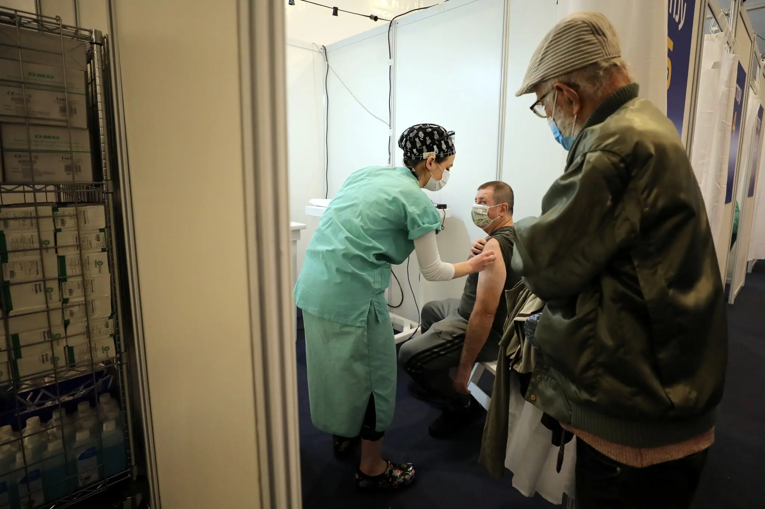
Age Group Finding:
A larger and earlier decrease in COVID-19 cases and hospitalization was observed in individuals older than 60 years, followed by younger age groups, by the order of vaccination prioritization.
A man receiving a vaccine at Rabin Square in Tel Aviv.
Source: Ammar Awad/ Reuters
Notes:
To reiterate, the findings so far showed that improvement in COVID-19 cases and hospitalizations were observed in age groups corresponding w/ the order of vaccine prioritization.

Slide 42
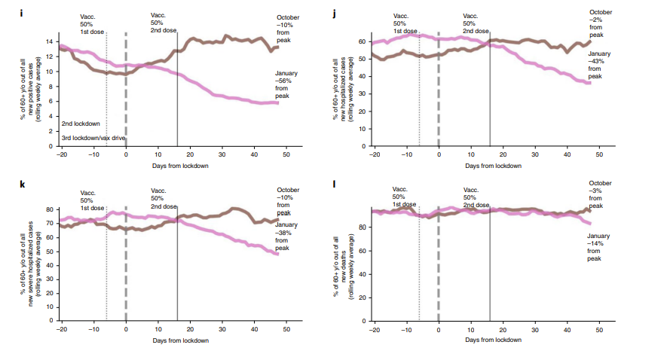
Notes:
These graphs compare the lockdown before vaccines were available in brown to the lockdown after vaccines were available in pink. The graphs show the % of all new covid cases that were the 60 year and older age group. It is clear to see that the rates among the 60+ y/o drop significantly after the vaccines began and that is why we only see a significant decrease in the pink line.

Slide 43
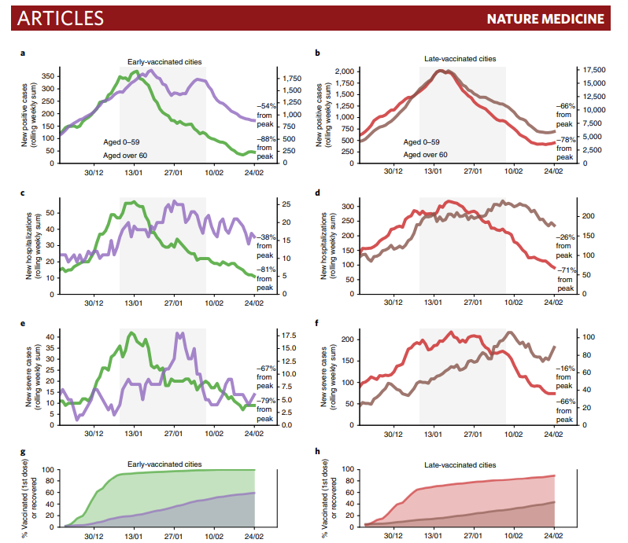
Early
Vs.
Late Vaccinated Cities
Notes:
These graphs illustrate the covid case/hospitalization rates in the 60+ age group versus the younger than 60 age group in early versus late vaccinated cities from the time the vaccination campaign was initiated. Again, the 60+ age group has the biggest decrease across the board (represented by the green lines on the left graphs and the red lines on the right graphs) The improvements are even more pronounced in the early-vaccinated cities.
l

Slide 44
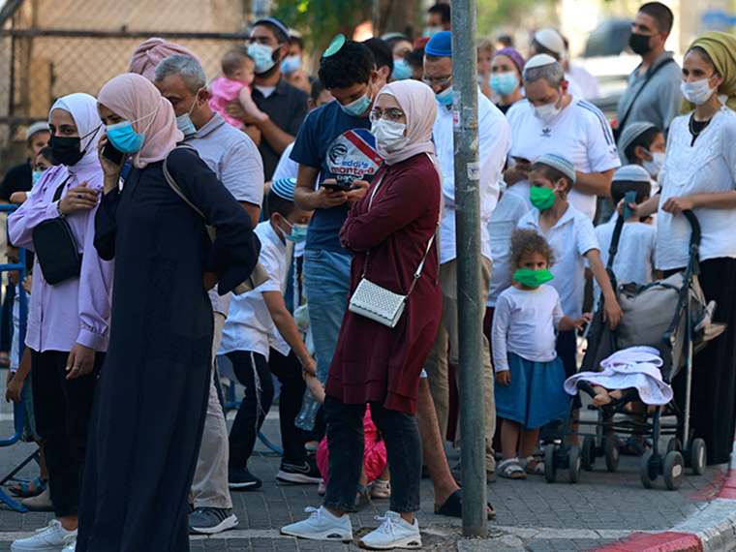
Finding:
The decrease in hospitalizations/COVID-19 cases was found in the 60+ age group in the 3rd lockdown, it was not observed in the 2nd lockdown. This finding was also significantly more pronounced in early-vaccinated cities
There is a clear pattern where areas in Israel with higher infection rates and a lower socioeconomic status have lower vaccination rates, despite widespread vaccine availability
Source: Getty Images
Notes:
Those late-vaccinated cities were areas in Israel w/ higher infection rates and a lower socioeconomic status. The cities had lower vaccination rates, despite widespread vaccine availability.

Slide 45
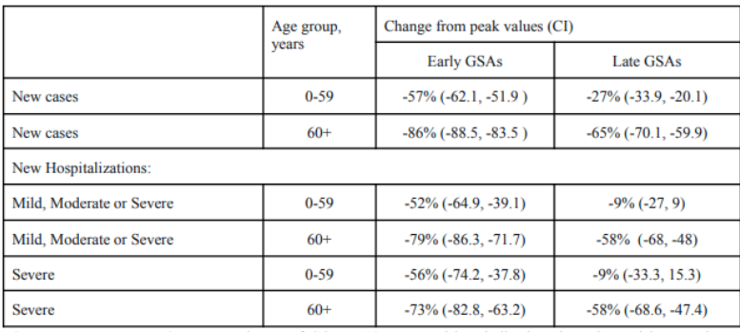
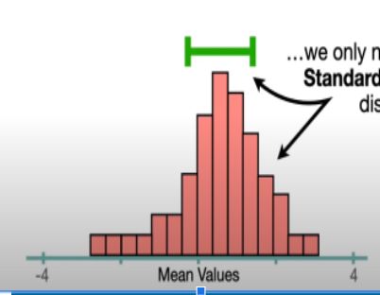
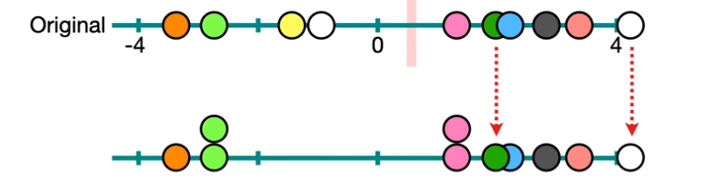
Calc. standard error
Notes:
The only statistical parameter in the paper was provided in supplementary material outside of the article. The authors mentioned that they further broke down early and late-vaccinated cities into smaller homogenous regions of roughly 3,000 people termed GSA’s. The difference between early and late-vaccinated regions was also seen here, so only the cities were included in the article for clarity.
The authors used bootstrap standard errors w/ their values. Bootstrap standard error aka the standard deviation of the bootstrap samples is an estimate of the standard deviation of the sampling distribution of the mean (so tells you how the mean is distributed). Bootstrapping simply uses random sampling w/ replacement on a sample to mimic the sampling process
To calculate the bootstrap standard error, we resample the original dataset of size k, k times w/ replacement so we can have repeat values.
-We calculate and store the mean of the resampling
-Then we repeat this process n times
-Finally we take the standard error from all of these resampled mean values.

Slide 46

Authors argued that the improvement was due to vaccine campaign
Improvements corresponded with the rollout of the age groups and occurred only once >50% of the age group was vaccinated
Correspondence with early-vaccinated cities (> % of population was vaccinated earlier)
Because there was no pattern observed in the 2nd lockdown (then there was no vaccine rollout)
Notes:
The authors conclusions from their observational analysis was that significant improvement in the 60+ age group can be explained by the vaccine campaign since the improvements only occurred when over 50% of the age group was vaccinated and corresponded w/ the rollout of age groups allowed to be vaccinated in the campaign. Also because of the correspondence w/ early-vaccinated cities. And lastly because there was no pattern observed in the 2nd lockdown (when there was no vaccine rollout) so we can rule out that the results we observed were due to the lockdown

Slide 47

Limitations
The study was an observational study, not a randomized clinical trial, so causal effects are difficult to infer.
2nd and 3rd lockdown reported cases could have been influenced by other factors: testing policy, public compliance w/ restrictions, hospitalization policy, total cases in beginning of each lockdown
Early vs late vaccinated city vaccine differences could be due to behavioral differences in populations
Preliminary results (data analyzed only until Feb 24 2021)
Notes:
There were a lot of limitations in the study. The study was, after all, an observational study, so causal effects are difficult to prove and infer.
The 2nd and 3rd lockdown reported cases could have been influenced by outside factors such as testing policy, public compliance w/ restrictions, hospitalization policy, total cases in the beginning of each lockdown.
Early vs late city vaccine differences could be due to behavioral or social differences in populations
These were preliminary results (data was only analyzed until February 24, 2021)

Slide 48
Overall, we show an analysis of large-scale, real-world data from Israel demonstrating real-life effectiveness of a national vaccination campaign. Although our findings are preliminary, they have major public health implications for the struggle against the COVID-19 pandemic. More studies aimed at assessing the effectiveness of the vaccination on reducing the transmission of SARS-CoV-2 are needed, both on the individual level and on the population level, with larger longitudinal follow-up and in additional populations.
Notes:
the big takeaway that the authors wanted to show is that their analysis demonstrated the real-life effect of a national vaccination campaign and the findings have generalizable public health implications and support the effectiveness of nationwide vaccination campaigns. They thought this paper could serve as a model for the effectiveness of a vaccination campaign to other countries that have not yet implemented one. They recommended further studies w/ larger longitudinal follow-up and on different populations.

Slide 49

Thank You!

